Slide 1
Mentor Session 2
Python Tutorial – Part 2: OOP
A compact tutorial to Linear Algebra
Numpy
Matplotlib

Slide 2

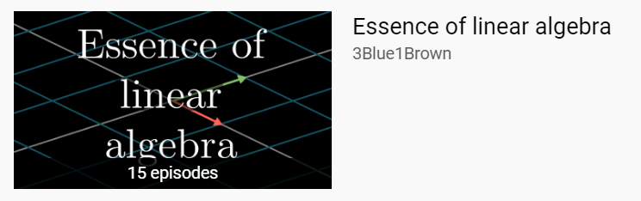
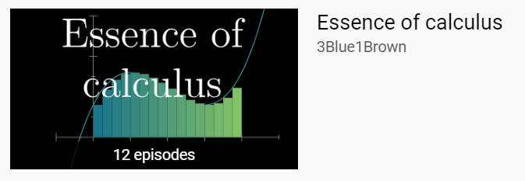
YouTube 3Blue1Brown

Slide 3
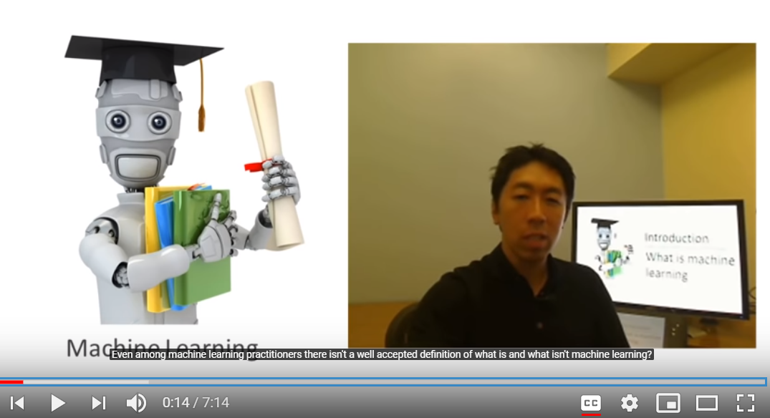
YouTube: Machine Learning | Andrew Ng

Slide 4
Download Academic Papers
1. Search it in Google Scholar: https://scholar.google.com/
2. Open the webpage, and copy the website
3. Find it in SCI-Hub: https://sci-hub.tw/

Slide 5
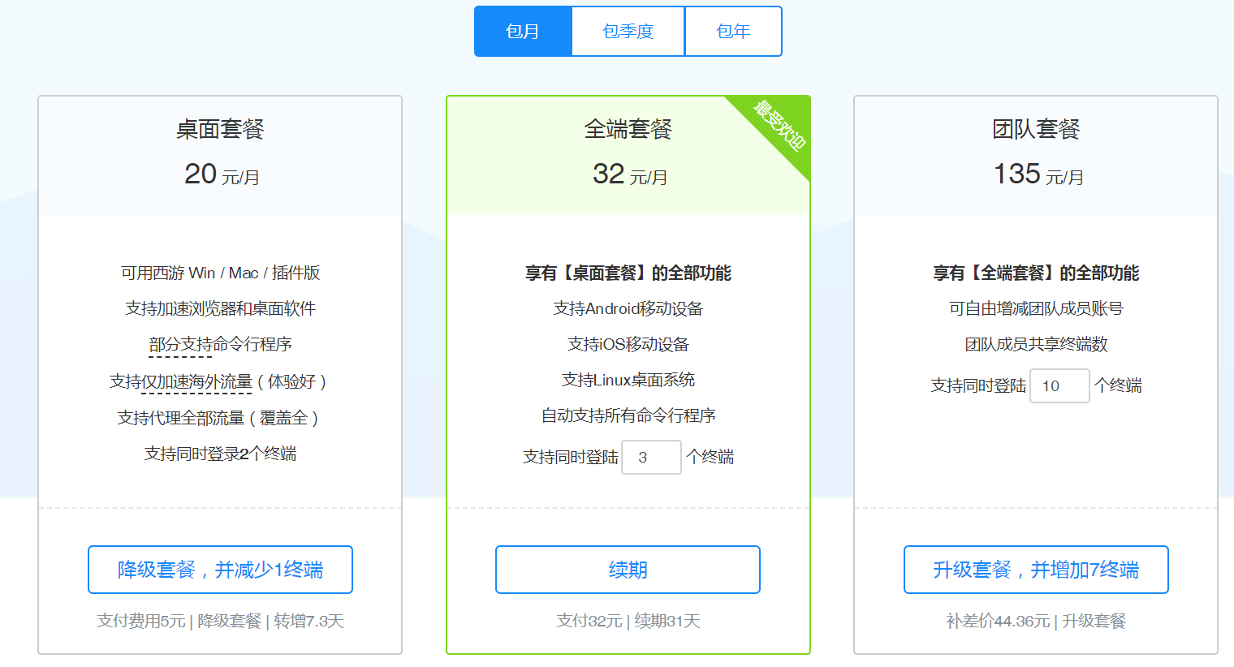
Scientific Internet (Flip the wall)
https://xiyou4you.us/r/?s=12491373
Google
Google Scholar
YouTube

